Slide 1
MVVM (Model – View – ViewModel)
Иван Џиковски
Ведра Стојановска

Slide 2
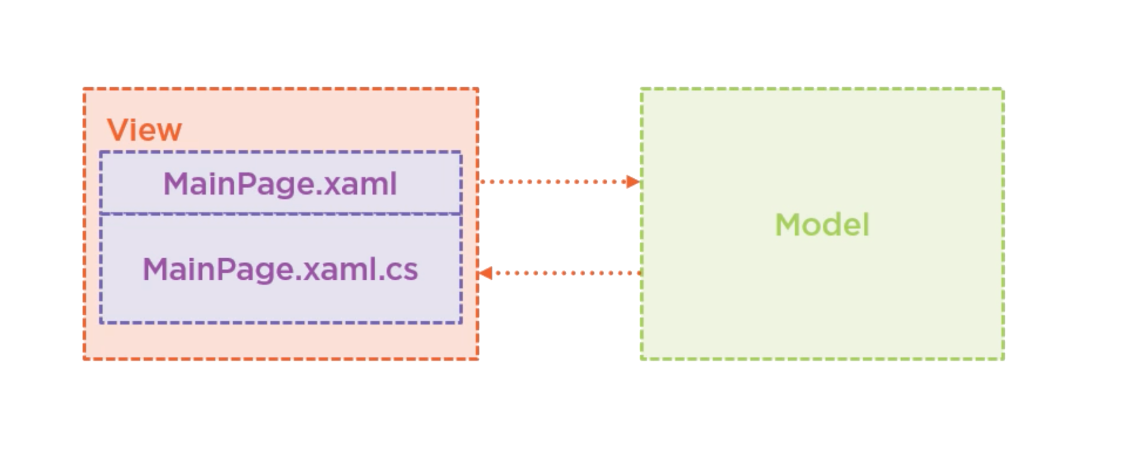
Why MVVM?

Slide 3
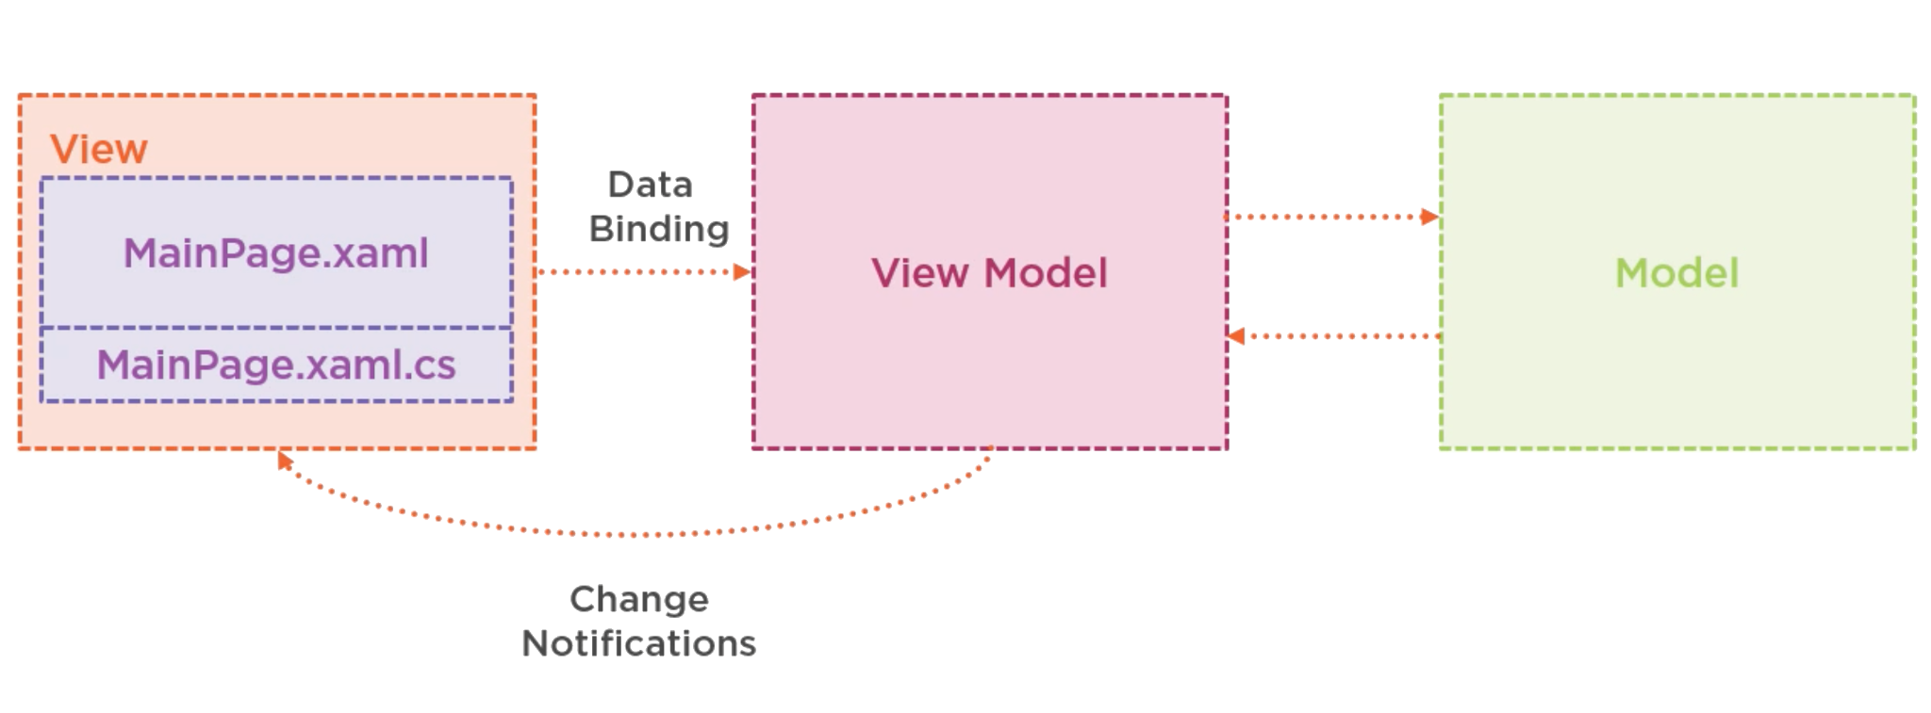
With MVVM

Slide 4
Pros and cons of using MVVM
clear separation of the ui and the business logic
easier to maintain and write tests for
the app can be redesigned if all UI is XAML
designers and developers can work in parallel
adds complexity and more code writing
might not be overkill for simple projects

Slide 5
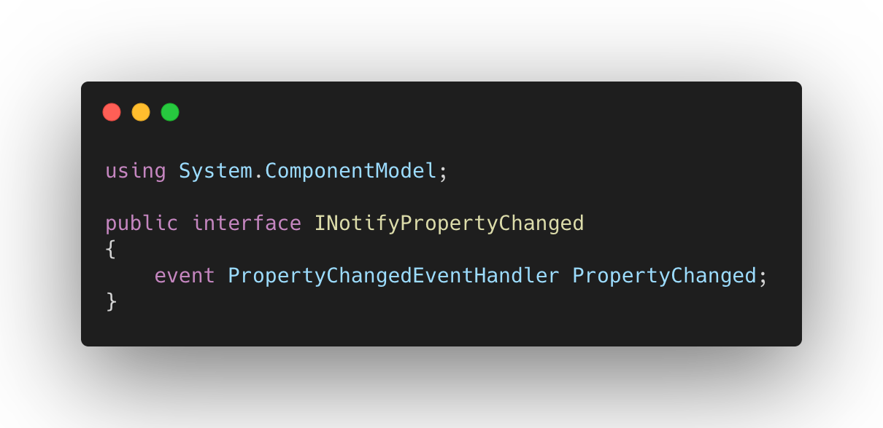
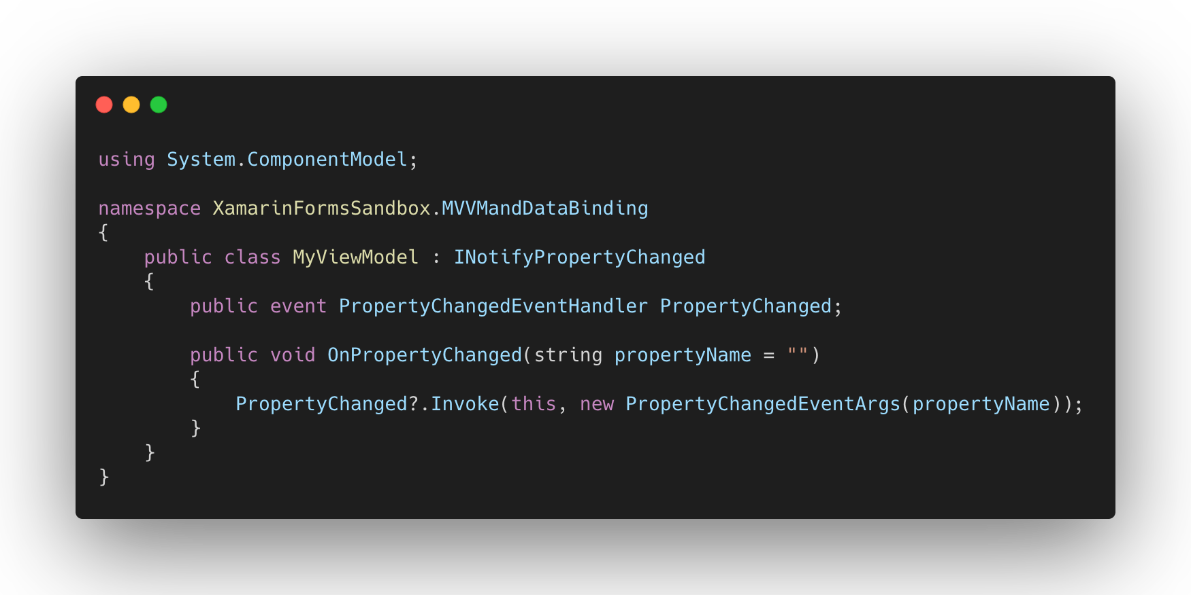
Data Binding in Xamarin.Forms

Slide 6
QUESTIONS?
You can find us at
ivan.dzikovski@gmail.com
vedrastojanovska@gmail.com
You can find the code at
Repository with the code Link

